Slide 1





Riemannian Local Mechanism for SPD Neural Networks
Ziheng Chen¹, Tianyang Xu¹, Xiao-Jun Wu^{* 1}, Rui Wang¹, Zhiwu Huang², Josef Kittler³
¹ School of Artificial Intelligence and Computer Science, Jiangnan University ² School of Computing and Information Systems, Singapore Management University ³ Centre for Vision, Speech and Signal Processing (CVSSP), University of Surrey

Slide 2
Background
Numerous non-Euclidean data
Riemannian Deep Learning
Great success of deep learning

Slide 3
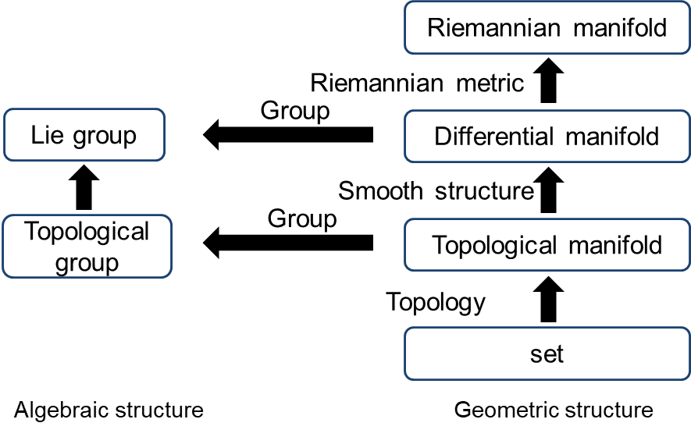
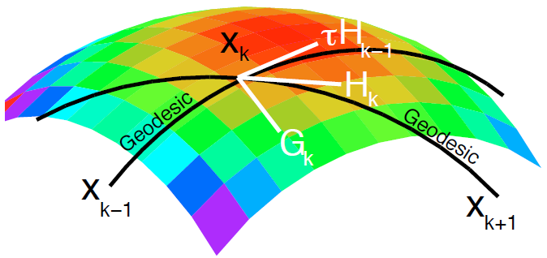
Preliminaries
What is manifold
Mani·fold
Most importantly, locally Euclidean

Slide 4
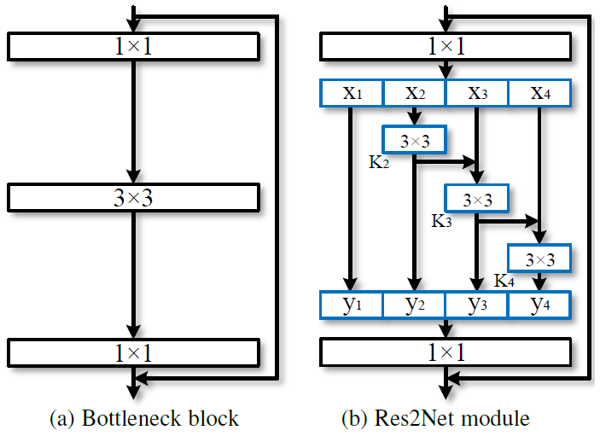
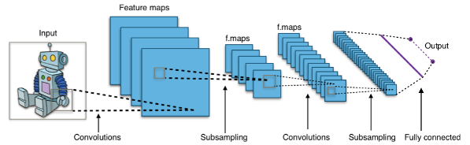
Motivation & Contribution
Motivation
Local mechanisms in Euclidean paradigms
Local patterns in Riemannian manifolds?
Typical CNNs
Res2Net
Missing local mechanisms in Riemannian algorithms;
Contribution
Successfully identify the local patterns in manifolds
Design the specific submanifold blocks for SPD neural networks

Slide 5

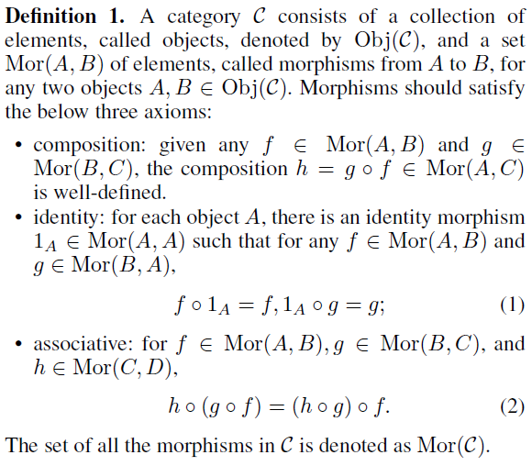
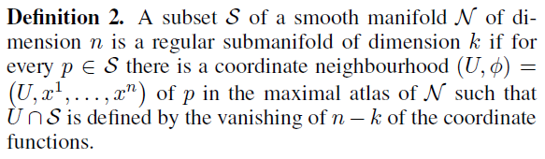
Main math tools
Category theory offers a universal view to consider diverse mathematical objects.
Regular submanifolds inherit multiple geometric properties from manifolds.

Slide 6

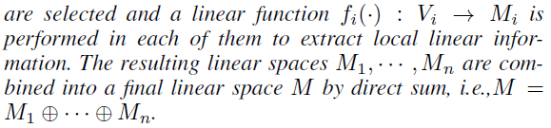
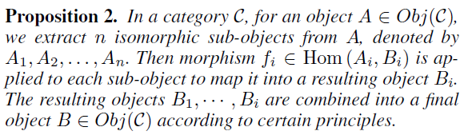
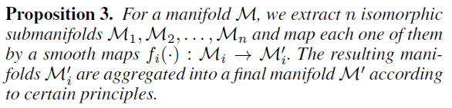
Proposed Method
How to describe the local pattern theoretically? Take convolution as an example
Linear Space
Cat Theory
Manifold

Slide 7
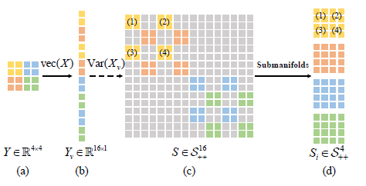
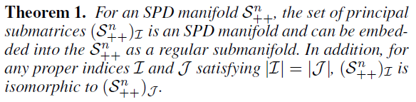
Proposed Method
How about in SPD manifolds?
Isomorphic principal submatrices
The number of submatrices is combinatorial
How to select?
Inspired by region covariance

Slide 8
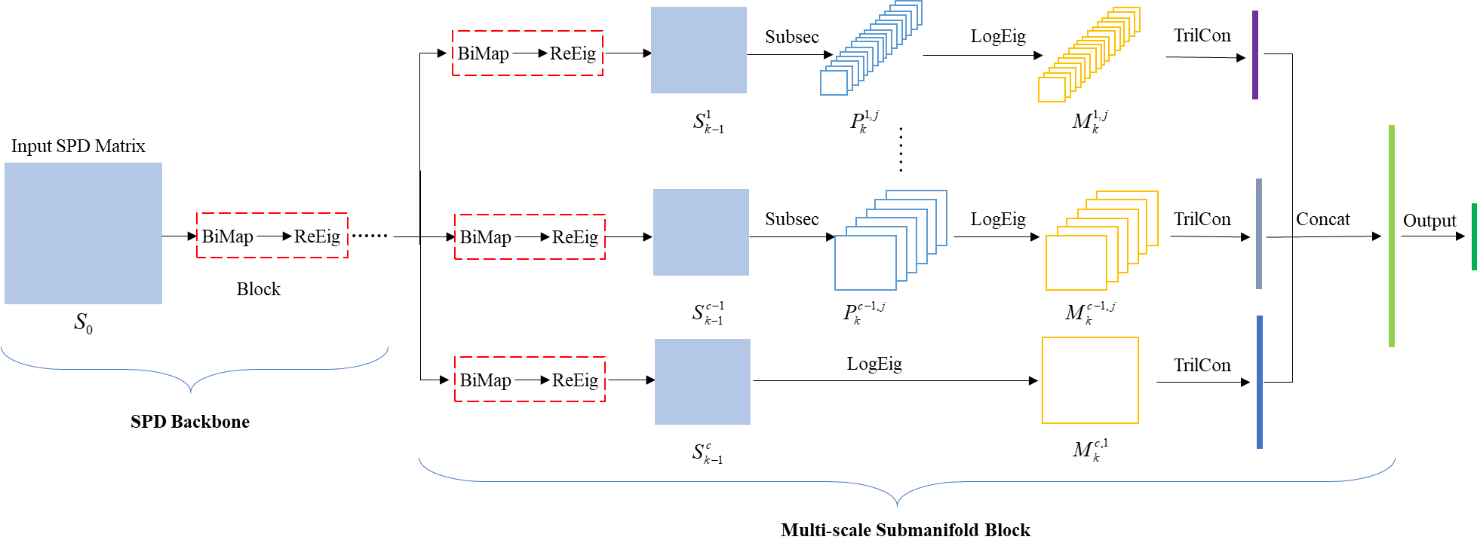
Proposed Method
Muti-scale mechanisms to capture vibrant local geometry
Both local and global geometry are effectively captured
Multi-scale Submanifolds Networks

Slide 9
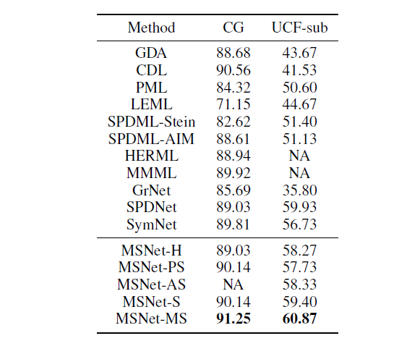
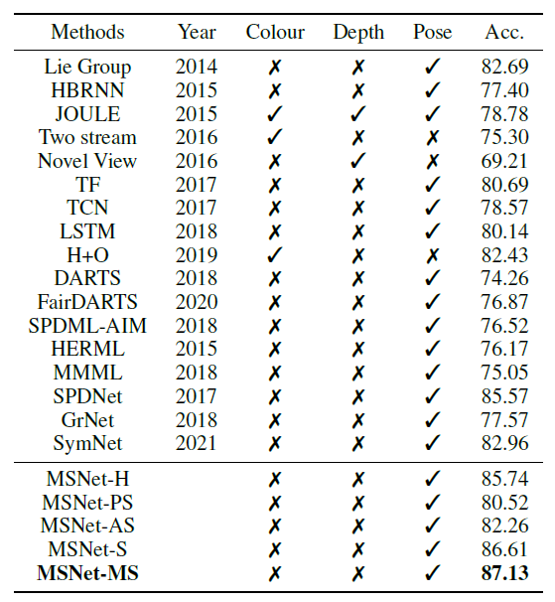
Experiments
Performance (%) on the CG and UCF-sub datasets.
Recognition Results (%) on the FPHA Dataset.

Slide 10
Resource
Code (Released soon): https://github.com/GitZH-Chen/MSNet
E-mail: ziheng_ch@163.com

